Slide 1
Kickstarter Prediction
PROJECT
Necmettin Çalıbaşı
Claudiu Gheorma
Ryan Goor
Shahrin Rahman
Group 42

Slide 2
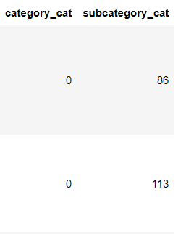
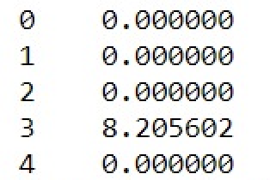
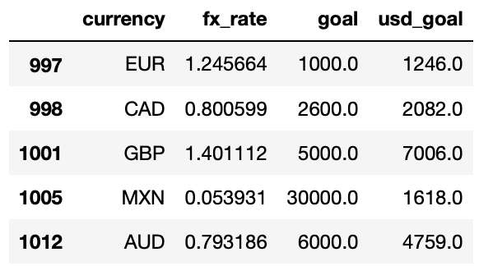
Derived Features
TF-IDF
USD_GOAL
CATEGORY_CAT
“Name” feature contains natural language
Standardizing the goal to match with usd_pledged
Label encoding of the category feature.

Slide 3
TF-IDF
Tokenize
Lemmatization
Removing punctuation and grammar
Finding the root word
Vectorization
Score Calculation
Counting the occurrence of words
Calculating the TF-IDF score.

Slide 4
USD_GOAL
FX_rate
New field
Predominant currency
We used the fx_rate to bring all the goals in the same currency.
We added a new field with the derived usd_goal. These values were rounded for improved readability.
We chose to transform all the goals in the most frequent currency.

Slide 5
Label Encoding
Category
Country
Subcategory
Taking “art” and encoding it to a number
Encoding the country
Possible improvement:
One hot encoding the feature instead of giving it a number.

Slide 6
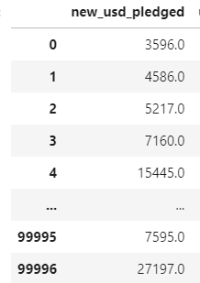
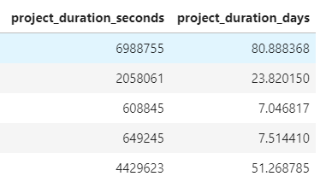
Features for Exploration
new_usd_pledged
Project_duration
We found an error in the data set
Making the data more readable

Slide 7
Model Choice - Random Forest
Large data set
Low Interpretability
Numeric & non-numeric Data Points
Hard to interpret
results due to the big number of decision trees that yield in the aggregated result.
Allows to use both numerical and non-numerical data, e.g usd_goal and staff_pick.
Useful for large data sets because of variable importance measure, OBB error detection.

Slide 8
Cross validation scheme
Computational time
Difference in scores
Choosing the right k
Choosing the number of folds to be as low as possible in order to maintain a reasonable computational time while trying to achieve a high validation score.
While trying different k-values, we observed that as the k increases, the improvement in performance increases only slightly more.
k value of 1 to 10 has been observed in validation graph and even though a value of k = 10 is common,
k = 5 was chosen in this project since it gives the best result in testing phase.

Slide 9
Optimizing Hyperparameters
Total number of trees
Final number
Using 5-fold validation, we plotted the accuracy score in regards to the number of trees.
After testing with different number of estimators (between 1 and 100), the best score was resulted from using 20 estimators.

Slide 10
Limitations, Interpretation & Evaluation
Limitations
Interpretation
Evaluation
Scope
Temporality
Black box model
Estimation - 49000

